Slide 1
B-Trees (continued)
Analysis of worst-case and average number of disk accesses for an insert.
Delete and analysis.
Structure for B-tree node

Slide 2
Worst-Case Disk Accesses
7 12
4
9
15 20
1 3
5 6
8
10
13
16 17
30 40
Insert 14.
Insert 2.
Insert 18.

Slide 3
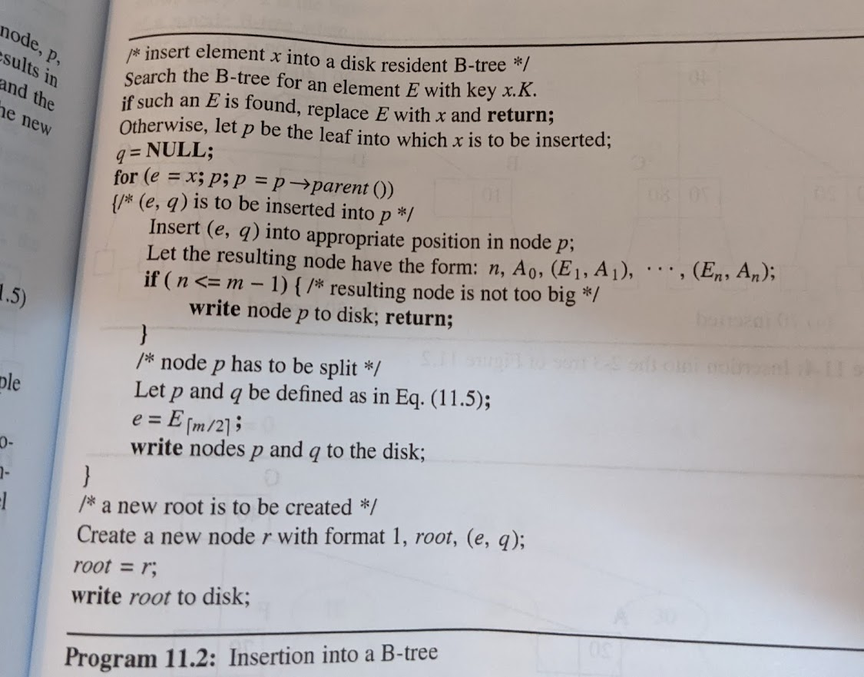

Slide 4
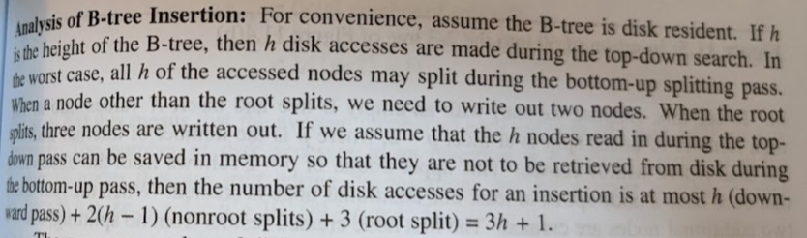

Slide 5
Worst-Case Disk Accesses
Assume enough memory to hold all h nodes accessed on way down.
h read accesses on way down.
2s+1 write accesses on way up, s = number of nodes that split.
Total h+2s+1 disk accesses.
  s=h
Max is 3h+1.

Slide 6
Average Disk Accesses
Start with empty B-tree.
Insert n pairs.
Resulting B-tree has p nodes.
# splits <= p –2, p > 2.
# pairs >= 1+(ceil(m/2) – 1)(p – 1).
s_{avg} <= (p – 2)/(1+(ceil(m/2) – 1)(p – 1)).
So, s_{avg} < 1/(ceil(m/2) – 1).
m = 200 => s_{avg} < 1/99.
Average disk accesses < h + 2/99 + 1 ~ h + 1.
Nearly minimum.
Notes:
Whenever the root splits, the number of nodes increases by 2. When any other node splits, the increase is by 1. The root splits at least once when p > 2.
An insert must make at least h read and 1 write access. So, h+1 is the minimum number of disk accesses for each insert. Therefore, the average is at least h+1.

Slide 7
Delete (2-3 tree)
8
2 4
15 20
1
3
5 6
9
16 17
30 40
Delete the pair with key = 8.
Transform deletion from interior into deletion from a leaf.
Replace by largest in left subtree.

Slide 8
Delete from a Leaf
8
2 4
15 20
1
3
5 6
9
16 17
30 40
Delete the pair with key = 16.
3-node becomes 2-node.

Slide 9
Delete from a Leaf
8
2 4
15 20
1
3
5 6
9
17
30 40
Delete the pair with key = 17.
Deletion from a 2-node.
Check one sibling and determine if it is a 3-node.
If so borrow a pair and a subtree via parent node.

Slide 10
Delete from a Leaf
8
2 4
15 30
1
3
5 6
9
20
40
Delete the pair with key = 20.
Deletion from a 2-node.
Check one sibling and determine if it is a 3-node.
If not, combine with sibling and parent pair.

Slide 11
Delete from a Leaf
8
2 4
15
1
3
5 6
9
30 40
Delete the pair with key = 30.
Deletion from a 3-node.
3-node becomes 2-node.

Slide 12
Delete from a Leaf
8
2 4
15
1
3
5 6
9
40
Delete the pair with key = 3.
Deletion from a 2-node.
Check one sibling and determine if it is a 3-node.
If so borrow a pair and a subtree via parent node.

Slide 13
Delete from a Leaf
8
2 5
15
1
4
6
9
40
Delete the pair with key = 6.
Deletion from a 2-node.
Check one sibling and determine if it is a 3-node.
If not, combine with sibling and parent pair.

Slide 14
Delete from a Leaf
8
2
15
1
4 5
9
40
Delete the pair with key = 40.
Deletion from a 2-node.
Check one sibling and determine if it is a 3-node.
If not, combine with sibling and parent pair.

Slide 15
Delete from a Leaf
8
2
1
4 5
9 15
Parent pair was from a 2-node.
Check one sibling and determine if it is a 3-node.
If not, combine with sibling and parent pair.

Slide 16
Delete from a Leaf
2 8
1
4 5
9 15
Parent pair was from a 2-node.
Check one sibling and determine if it is a 3-node.
No sibling, so must be the root.
Discard root. Left child becomes new root.

Slide 17
Delete from a Leaf
2 8
1
4 5
9 15
Height reduces by 1.

Slide 18
Delete a Pair
Deletion from interior node is transformed into a deletion from a leaf node.
Deficient leaf triggers bottom-up borrowing and node combining pass.
Deficient node is combined with an adjacent sibling who has exactly ceil(m/2) – 1 pairs.
After combining, the node has [ceil(m/2) – 2] (original pairs) + [ceil(m/2) – 1] (sibling pairs) + 1 (from parent) <= m –1 pairs.

Slide 19
Disk Accesses
7 12
4
9
15 20
3
5 6
8
10
13
16 17
30 40
Minimum.
Borrow.
Combine.
Notes:
Minimum is when you delete 5, for example.

Slide 20
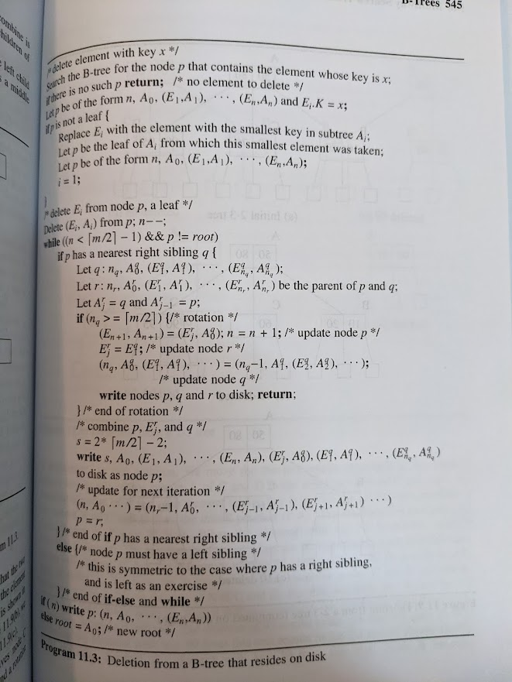

Slide 21
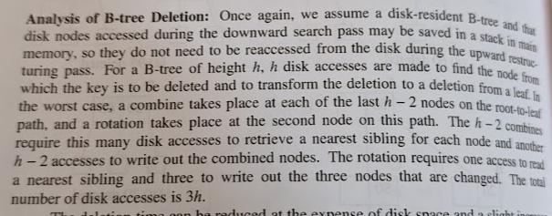

Slide 22
Worst-Case Disk Accesses
Assume enough memory to hold all h nodes accessed on way down.
h read accesses on way down.
h – 1 sibling read accesses on way up.
h – 2 writes of combined nodes on way up.
3 writes of root and level 2 nodes for sibling borrowing at level 2.
Total is 3h.

Slide 23
Internal Memory B-Trees
Cache access time vs main memory access time.
Reduce main memory accesses using a B-tree.

Slide 24
Node Structure
q a₀ p₁ a₁ p₂ a₂ … p_{q} a_{q}
Node operations during a search.
  Search the node for a given key.
Notes:
a’s are subtree pointers, p’s are dictionary pairs

Slide 25
Node Operations for Insert
  Insert a dictionary pair and a pointer (p, a).
m a₀ p₁ a₁ p₂ a₂ … p_{m} a_{m}
ceil(m/2)-1 a₀ p₁ a₁ p₂ a₂ … p_{ceil(m/2)-1} a_{ceil(m/2)-1}
m-ceil(m/2) a_{ceil(m/2)} p_{ceil(m/2)+1} a_{ceil(m/2)+1} … p_{m} a_{m}
  Find middle pair.
  3-way split around middle pair.

Slide 26
Node Operations for Delete
Delete a dictionary pair.
Borrow.
  Delete, replace, insert.
Combine.
  3-way join.

Slide 27
Node Structure
Each B-tree node is an array partitioned into indexed red-black tree nodes that will keep one dictionary pair each.
Indexed red-black tree is built using simulated pointers (integer pointers).

Slide 28
Complexity of B-Tree Node Operations
Search a B-tree pair … O(log m).
Find middle pair … O(log m).
Insert a pair … O(log m).
Delete a pair … O(log m).
Split a B-tree node … O(log m).
Join 2 B-tree nodes … O(m).
  Need to copy indexed red-black tree that represents one B-tree node into the array space of the other B-tree node.

